Slide 1
The SC Employment First Initiative: An Overview
Charlie Walters
Director of Transition Programs
Able SC

Slide 2
SCEFI Background
A five year systems-change (and culture change) grant, awarded in September 2016, to increase competitive, integrated employment outcomes for young adults with intellectual and developmental disabilities
Collaborative approach to addressing employment barriers with core agencies (our state’s PTI, Family Connection of SC, included
Housed within the SC Disability Employment Coalition, an interagency task force on disability employment
Notes:
While the focus is on youth with ID/DD and we have specific goals targeted to that group, we are focusing on increasing employment opportunities for all PWDs. What is systems change? To first accept, this we have to realize that we have a broken system. We have a system focused on deficits and not focused on strengths.
Funded by Administration for Community Living (logo pictured)

Slide 3
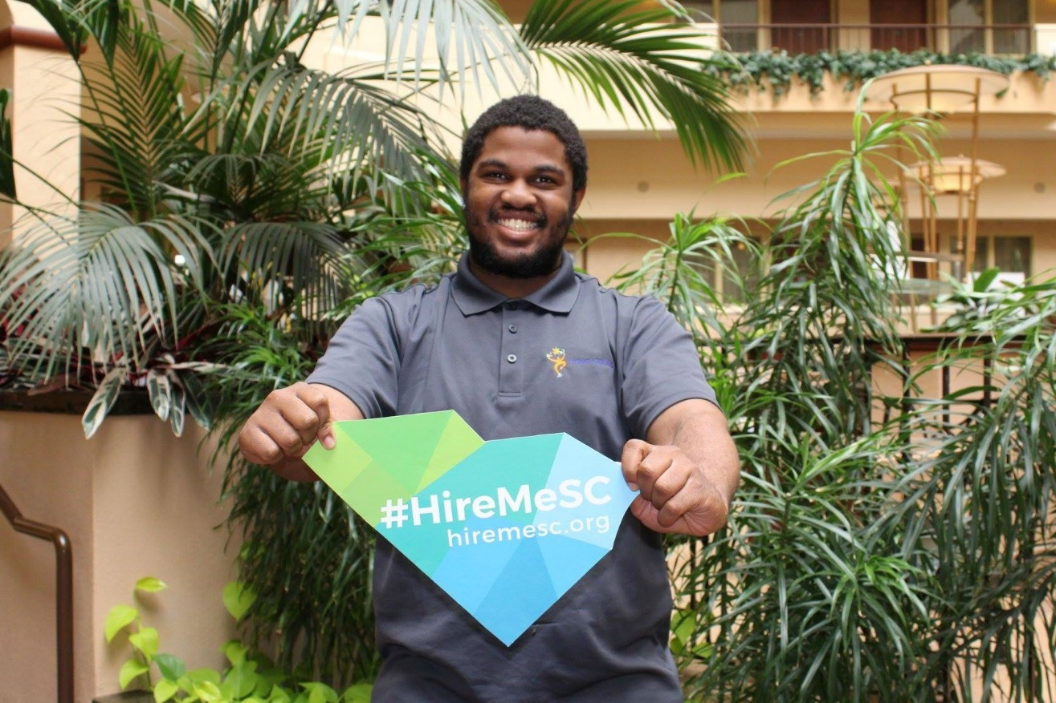
Youth with Disabilities
Pilot Program
-Increasing the frequency of paid, community based employment experiences through data-based, interagency decision making
-Currently in 4 school districts
Started 4 youth peer support groups focused on employment
Self-advocacy campaign (Hire Me SC)
Notes:
Pilot program: Meeting monthly and collecting data -work experiences -referrals to VR and DDSN
-Flow of Services to point back to responsibilities and expectations.
During year 1 of the pilot program, we saw a 108% increase (15 out of 27 pilot students) in Berkley involved in competitive employment experiences. a 650% increase (15 out of 37 pilot students) in Richland involved in competitive employment experiences.

Slide 4
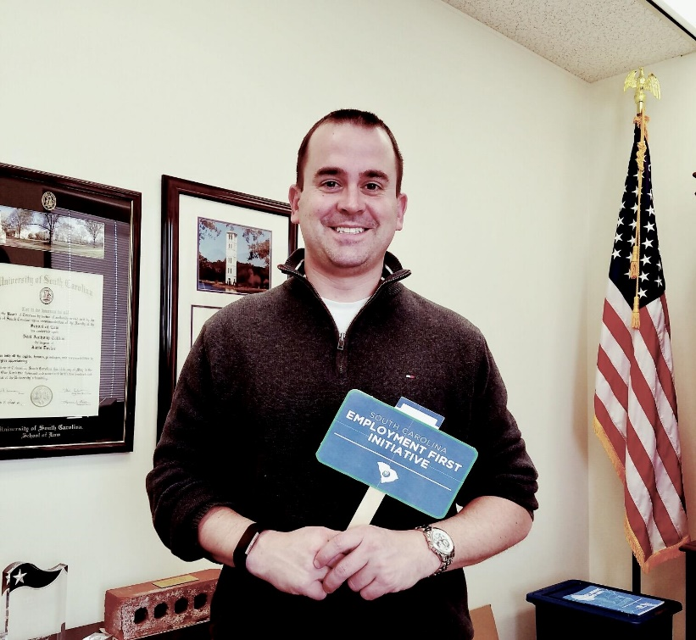
Professionals, families, and the community
12 Employment First Trainings
Developed SC APSE chapter
Employment First Legislation
Introduced in April 2017
Established EF Study Committee
Educating lawmakers vs. lobbying
Lawmakers as champions
Supported Decision Making
23 families received counseling
241 professionals & family members trained
Notes:
12 trainings to a variety of educators, service providers, and state agencies on the principles and practices of Employment First and best practices for EF.
SC APSE chapter-final stages of developing fully charted chapter. Currently 8 board members and over 30 chapter members.
EF legislation-introduced in April 2017. Revised in the third reading. Now a study committee to determine if permanent legislation is needed. Report due 5/1/2019.
Last year, added SDM as a part of SCEFI as we know guardianship can limit employment opportunities. As a part of SCEFI, currently 23 families received one-on-one counseling and 241 professionals and family members attended training about alternatives to guardianship.

Slide 5
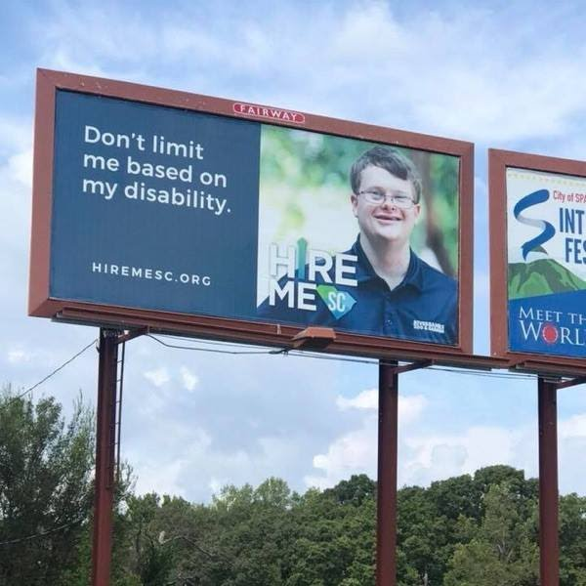
Campaign launched in September 2018
29 billboards throughout South Carolina
New website, marketing materials, and social media accounts
Focused media outreach in Columbia
Notes:
Hire Me SC logo: Blue and green. I in Hire is a arrow pointing up and SC has the outline of South Carolina behind it.
Photo: Karl’s billboard which says Don’t limit me based on my disability.
Stats are as of end of 2018. Billboards purchased for a month, many left up after a month. 2.9 million guaranteed impressions and estimated overall media impression of 5.8
Website-unique visitors 2,224. Most visited pages: home, job seekers, and events. Majority of folks visiting site from SC (Columbia, Greenville)
New marketing materials: rack cards and Hire Me SC signs
Focused media outreach in Columbia. Several news articles and live tv spots about Hire Me SC. Highlights: ABD with Curtis Wilson, WIS Talk of the Town, WACH Fox “Good Day Columbia”, Carolina News and Reporter.

Slide 6
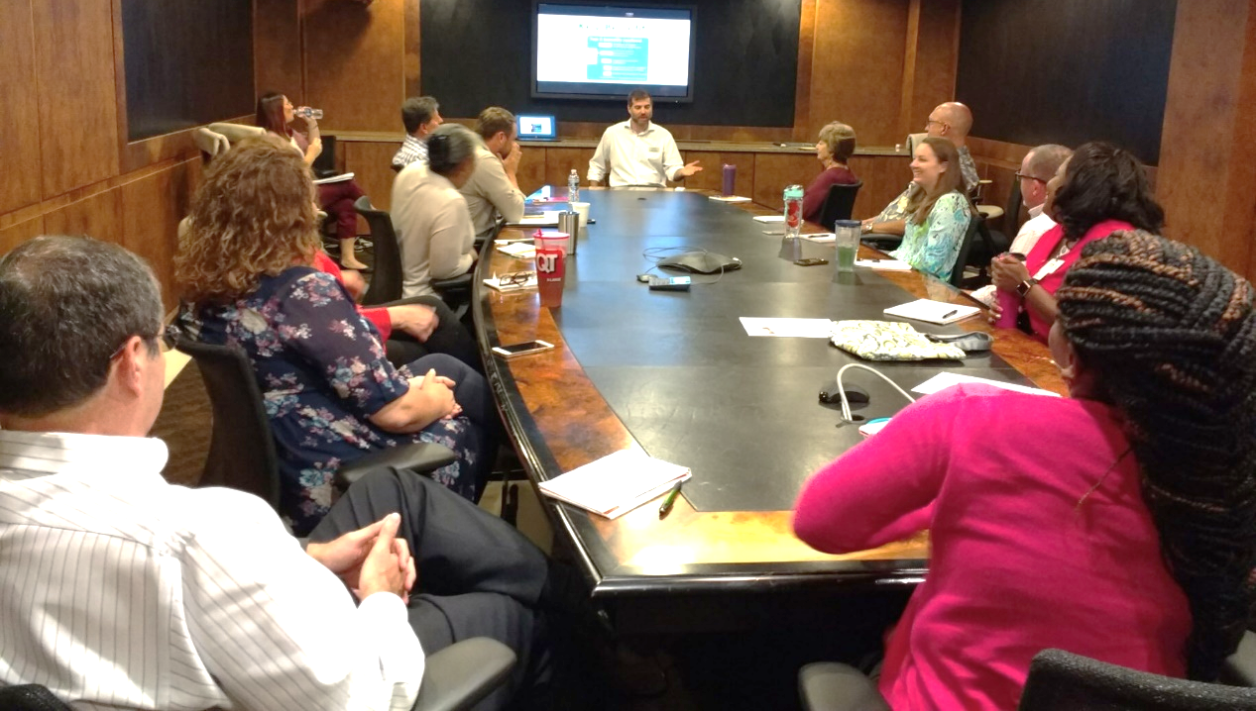
Employers
Trained 269 employers
Assisted 7 employers with changing policies
Hosted 3 Employer Summits
95% state they plan to modify existing policies and procedures in order to employ and retain more employees with disabilities
Started Business Coalition with current active participation of 20 employers
Notes:
269 employers (through 20 trainings) trained on engaging people with disabilities in employment. Discuss benefits of employing PWDs, ADA, accommodations, . Recently approved for 1 hour of SHRM and 1 hour of HRCI credit.
Assisted Beginnings SC with changing their EEOC statement and adding language about the availability of job accommodations.
Hosted 3 employer summit. Averages about 70 employers. Held in October to celebrate NDEAM.
Provided technical assistance to 7 employers to implement or change their policies to increase hiring of people with disabilities.

Slide 7
Charlie Walters: Director of Transition Programs at Able SC
Toll-Free: 1.800.681.7715
E-mail: cwalters@able-sc.org
Notes:
Photo: guy with his hand on his face with question marks around his head.

