Slide 1
An Introduction to the New Vocational Rehabilitation Toolkit for Parent Centers January 15, 2020
Welcome! The webinar will begin shortly.
Attendee Participation
Open and close your control panel.
Join audio:
Choose Mic & Speakers to use VoIP
Choose Telephone and dial using the information provided
If you are joining the audio by telephone mute your computer speakers
Submit questions and comments via the Questions panel.
Note: Today’s presentation is being recorded and will be provided within 48 hours.
Notes:
SPEAKER
Intro Script:
Good Afternoon everyone, my name is [ ] and I would like to welcome you to today's webinar: [ ].
Before we get started, I’d like to go over a few items so you know how to participate in today’s event.

Slide 2
Notes:
SPEAKER (Acquaint your Attendees with what they see on their screen.)
You will notice on your screen, a screenshot of an example of the GoToWebinar interface.
You should see something that looks like this on your computer desktop in the upper-right corner.
You’re listening in using your computer's speaker system by default.
If you would prefer to join over the phone, just select “Telephone” in the Audio pane and the dial-in information will be displayed.
Be sure to put in your unique Pin.
Also, the control panel will collapse automatically when not in use. To keep it open, click the “View” menu and uncheck “Auto-hide Control Panel”.
Please Note: Today’s presentation is being recorded and will be available to you on the RAISE Website within a week of this live presentation. We will send you the link when it becomes available.

Slide 3
Questions
Your Participation
Please continue to submit your text questions and comments using the Questions panel
Please raise your hand to be unmuted for verbal questions.
Note: Today’s presentation is being recorded and the link will be sent to you when it is available.
Notes:
SPEAKER (Acquaint your Attendees with what they see on their screen.)
To the right of the GoToWebinar PowerPoint viewer, is the GoToWebinar Control Panel. This is where you have the option to select the way you hear the webinar, raise your hand, and ask questions by text.
You will have the opportunity to submit text questions to today’s presenters by typing your questions into the “Questions for staff” section of the control panel. You may send in your questions at any time during the presentation; we will collect these and address them during the Q&A session at the end of today’s presentation.
Reminder: You can also download the webinar handouts and PowerPoint from the GoToWebinar Control Panel.

Slide 4
Meet the RAISE Team
Dr. Josie Badger · Co-Director
Peg Kinsell · Co-Director
Debra Jennings · Executive Co-Director of SPAN Parent Advocacy Network
Myriam Alizo · Resource and Product Coordinator
Maria Rodriguez · Administrative Assistance
Jessica Wilson · Director of Communication and Dissemination
Notes:
Josie

Slide 5
The National RAISE Technical Assistance Center
welcomes you to:
An Introduction to the New Vocational Rehabilitation Toolkit for Parent Centers
Adapted from the National Disability Rights Network (NDRN) document: Work, Assistive Technology and State Vocational Rehabilitation Agencies: The Vocational Rehabilitation Agency’s Obligation to Fund AT to Support Employment Preparation by Ronald M. Hager, Esq., September 2018
raisecenter.org/wp-content/uploads/2019/06/VR-Funding-of-AT-2018.pdf
Presenters
Rick Considine, Considine Communications
Peg Kinsell
Jessica Wilson
Notes:
Josie

Slide 6
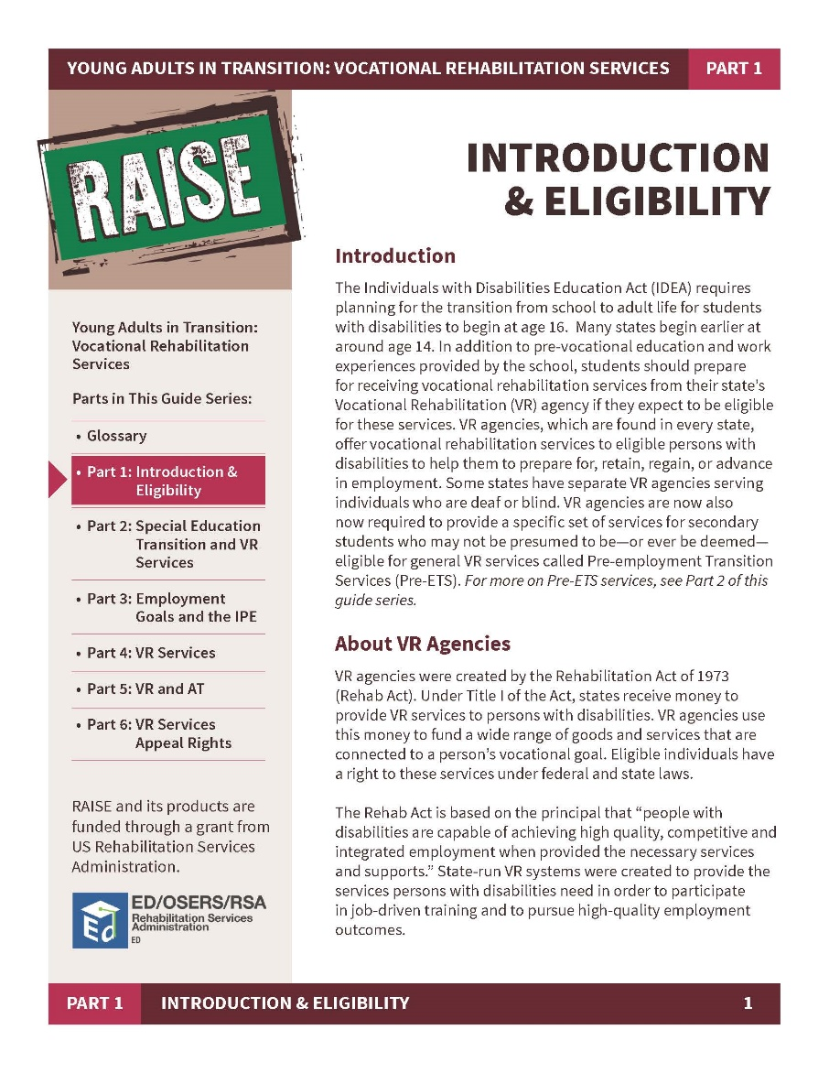
The full document
raisecenter.org/wp-content/uploads/2020/01/RAISE-VR-Toolkit.pdf

Slide 7
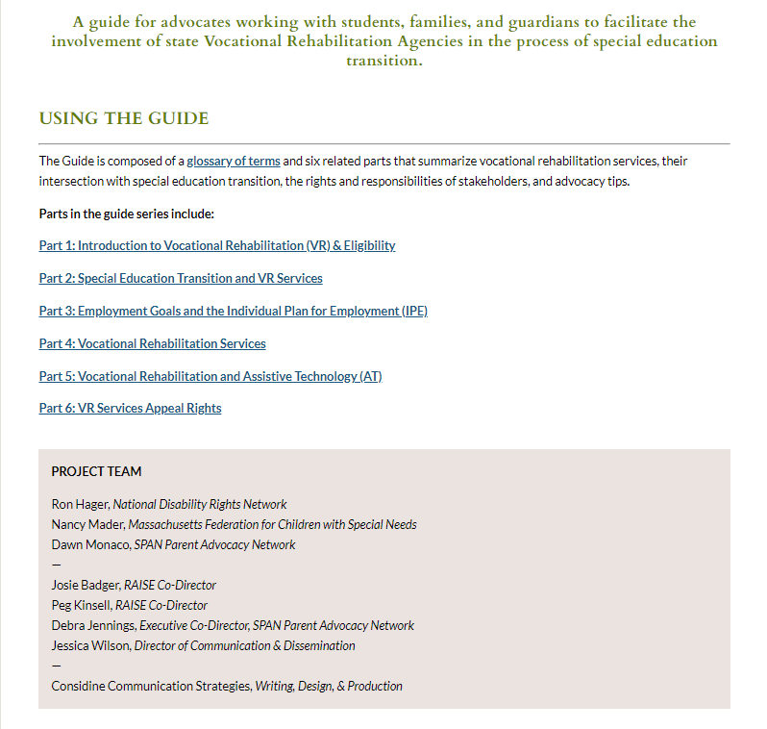
The online version
parentcenterhub.org/young-adults-in-transition-vr-services

Slide 8
Thank You for joining us for this Webinar! Please complete our survey
For more information, please contact us at: raisecenter.org
Contact Information:
Josie Badger, jbadger@raisecenter.org
Peg Kinsell, pkinsell@spanadvocacy.org
Jessica Wilson, jwilson@spanadvocacy.org
Notes:
[SPEAKER]
● Here is the RAISE Center website and the presenter’s contact information.
● You will get a survey immediately after the webinar is over. Please complete our survey.
Thank you!

